Slide 1
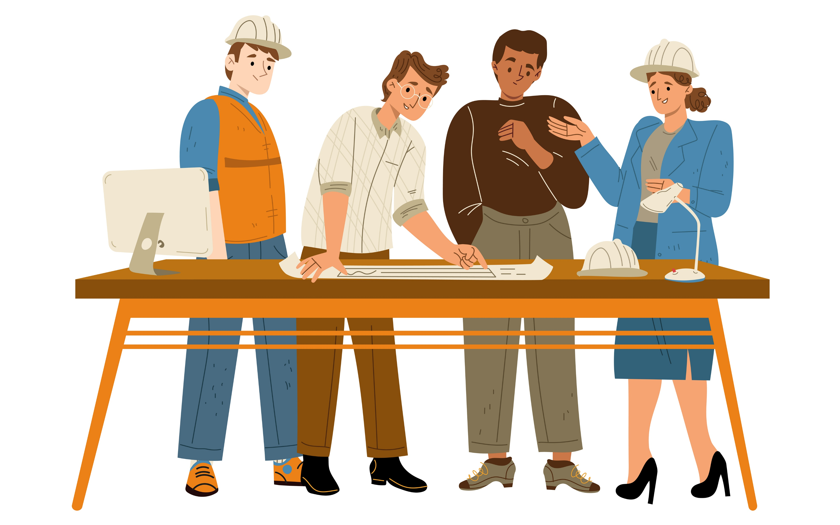
Character Project!

Slide 2
เป้าหมาย
เพื่อสร้างเว็บเพจที่สามารถสร้าง และ ปรับแต่งตัวละครได้เพื่อสร้างเว็บเพจที่แสดงข้อมูลที่เกี่ยวข้องกับตัวเองได้

Slide 3
กลุ่มผู้ใช้
17 – 40 ปี

Slide 4
Expectation Work, Plan and Scope vs Reality Work, Plan and Scope
Login/register page: can login create new account and recover password.
Homepage: can navigate to Profile, Store, Inventory and Daily login page.
Profile page: Show user info, user can go to edit avatar and bio.
Edit Avatar page: show user avatar, user can change avatar
Edit Description page: user can change their description
Store page: user can go through all of the Avatarparts that we provided!
Daily login page: user can get their money or coin here
Inventory page: user can go through all of the user Avatarparts that user already purchase
Login/register page: can login, can make a new account.
Homepage: can navigate to Profile and Store.
Profile page: Show user info, user can go to edit avatar and bio.
Edit Avatar page: show user avatar, user can change avatar and save to user pc but it will not update the user avatar in the web
Edit Description page: user can’t change their description
Store page: user can go through all of the Avatarparts that we provided!... Only 3 now..

Slide 5
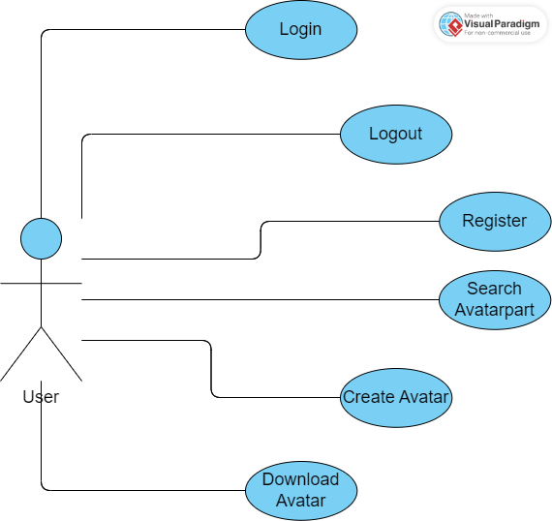
Use case

Slide 6
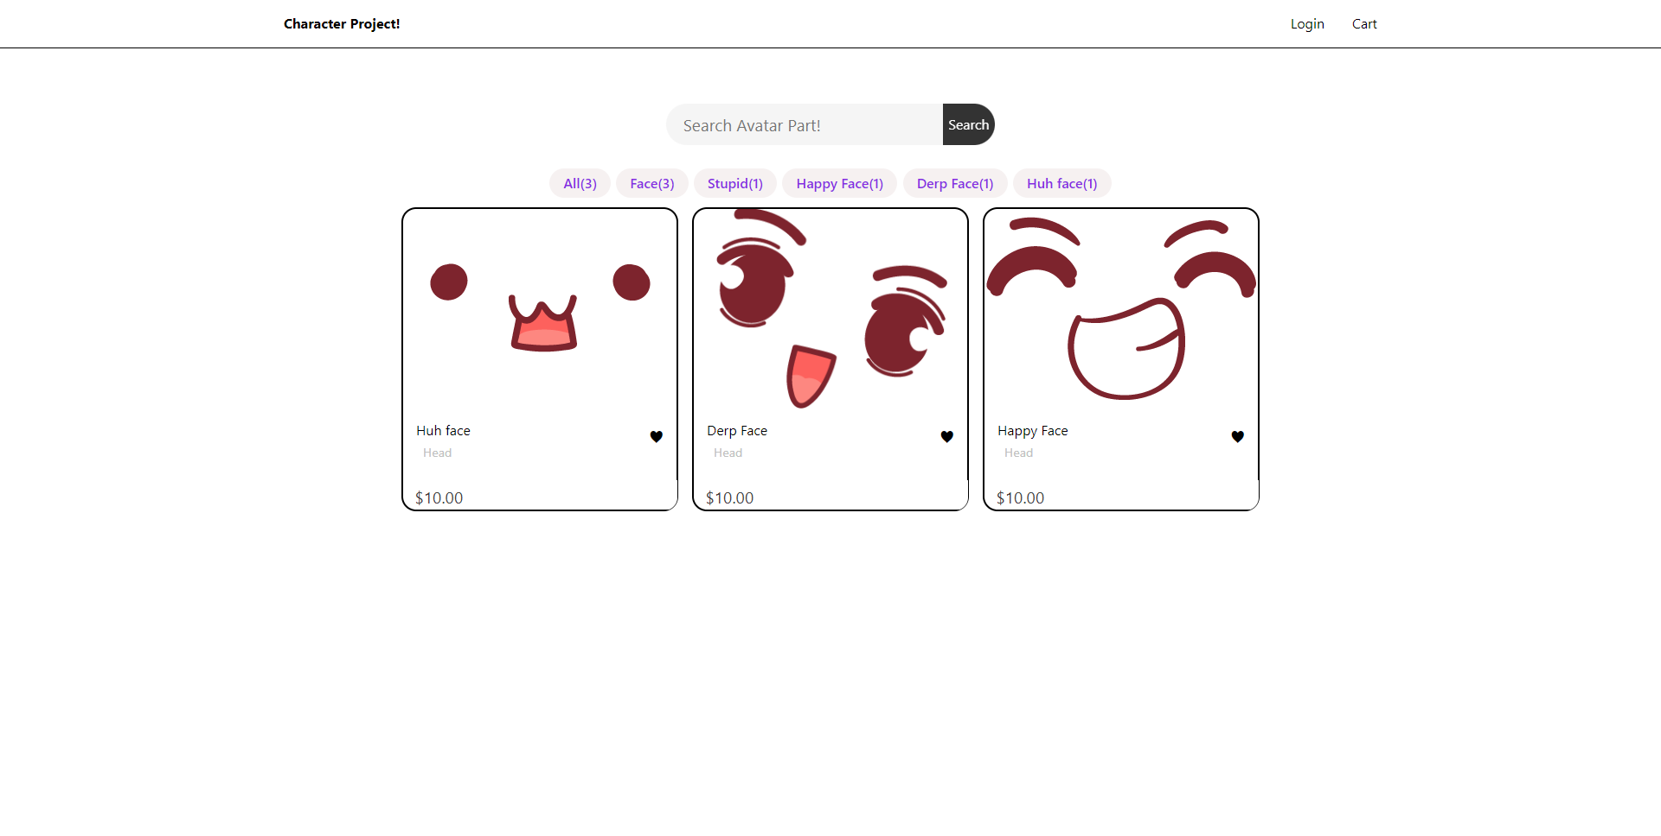
Homepage

Slide 7
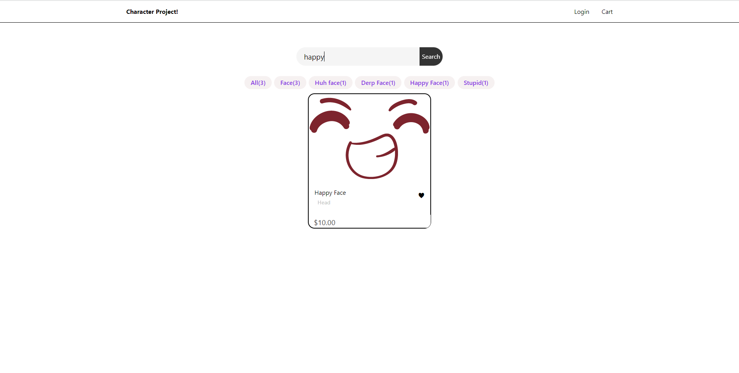
Searching

Slide 8
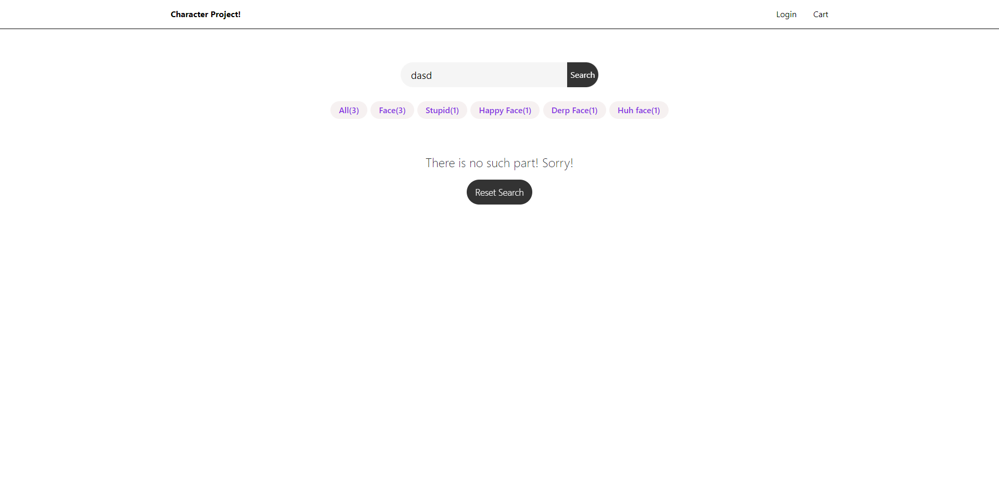
Searching

Slide 9
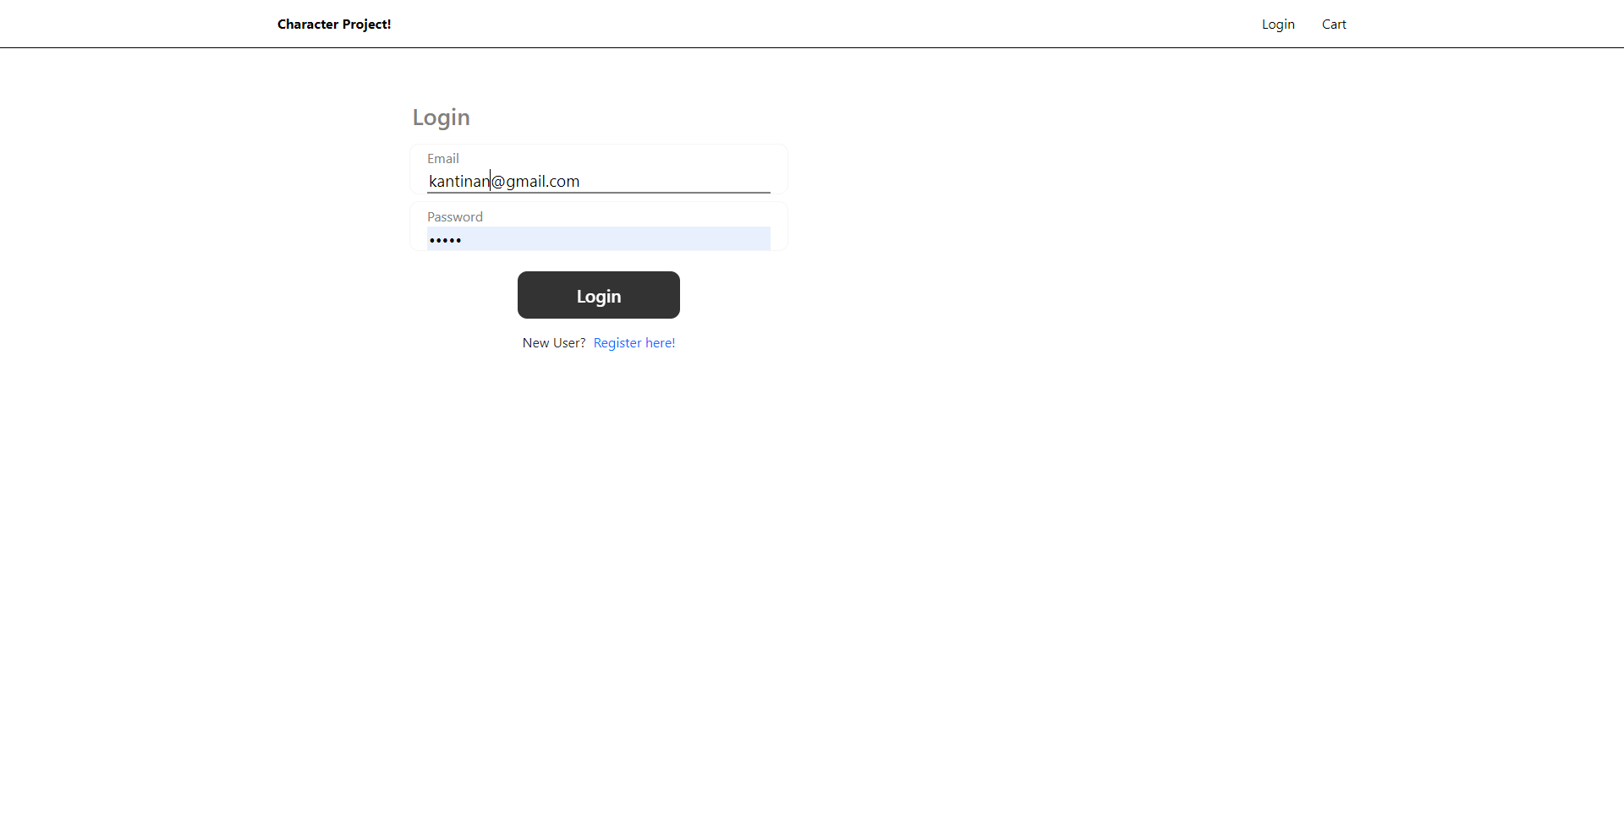
Login

Slide 10
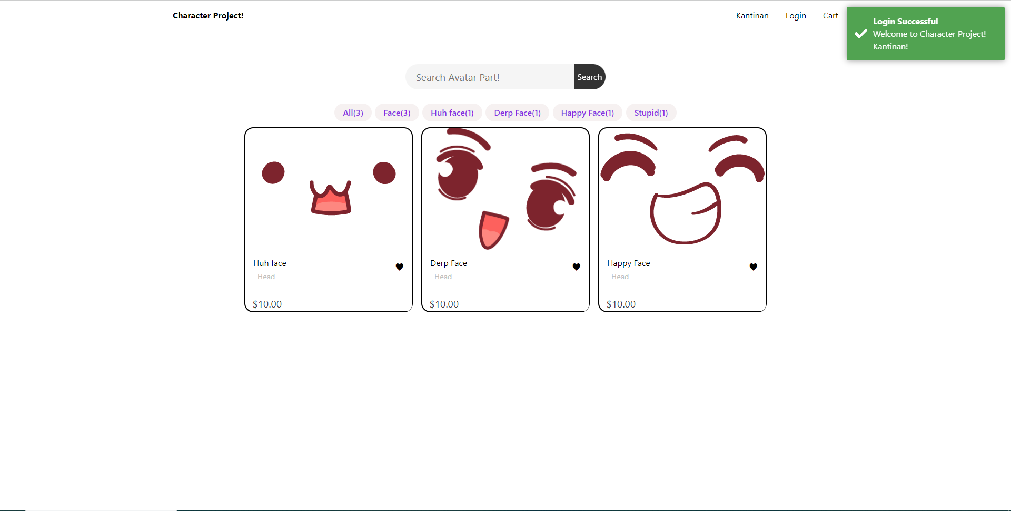
Login

Slide 11
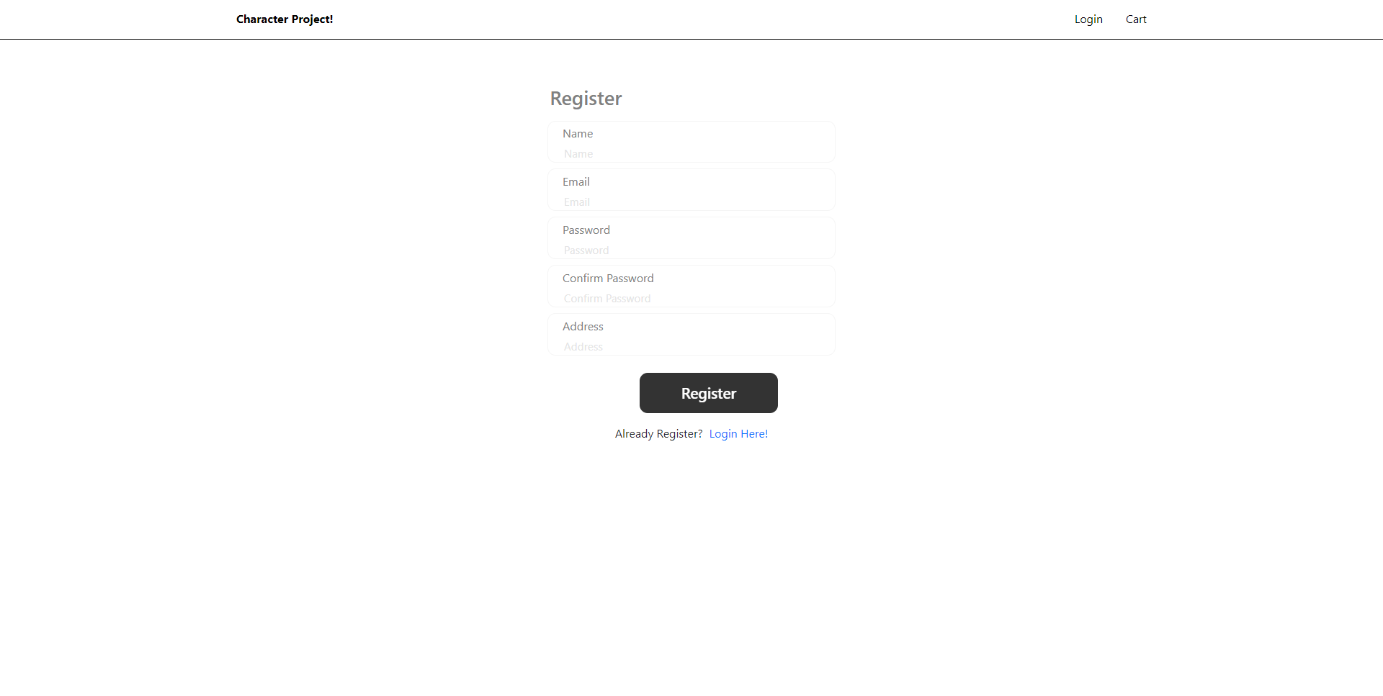
Register

Slide 12
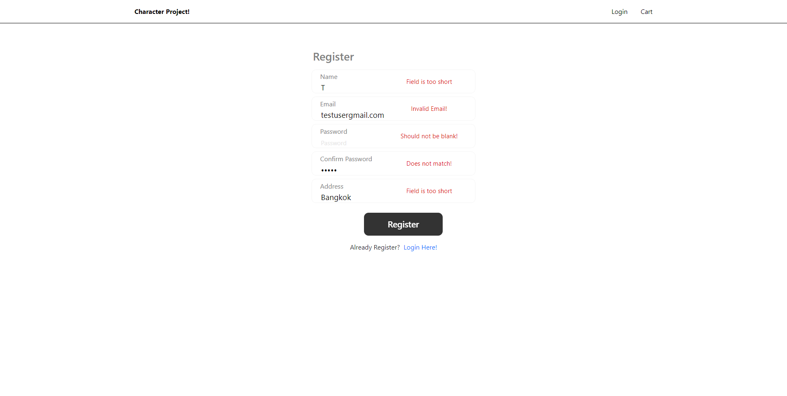
Register

Slide 13
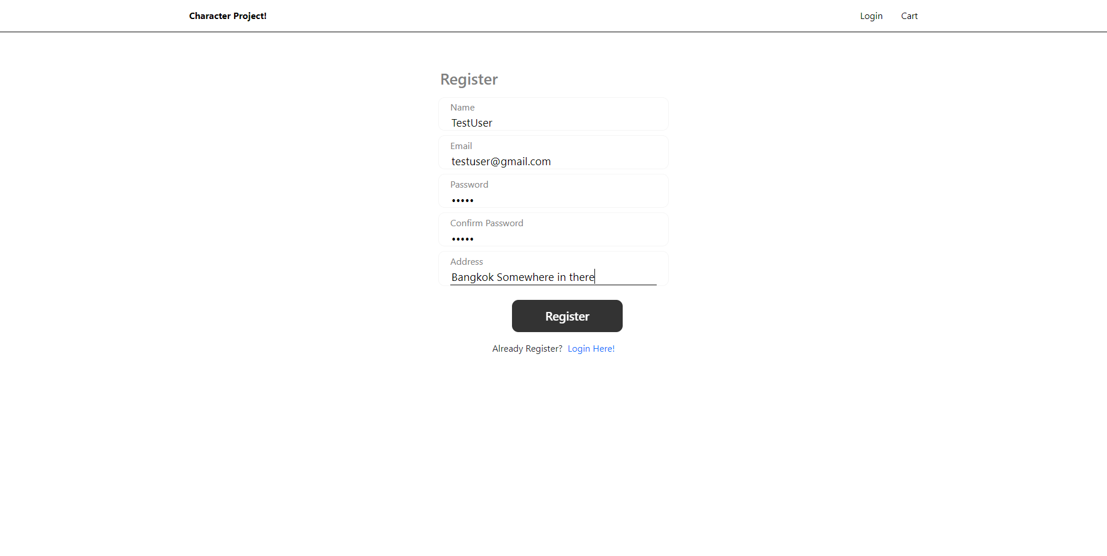
Register

Slide 14

Register

Slide 15
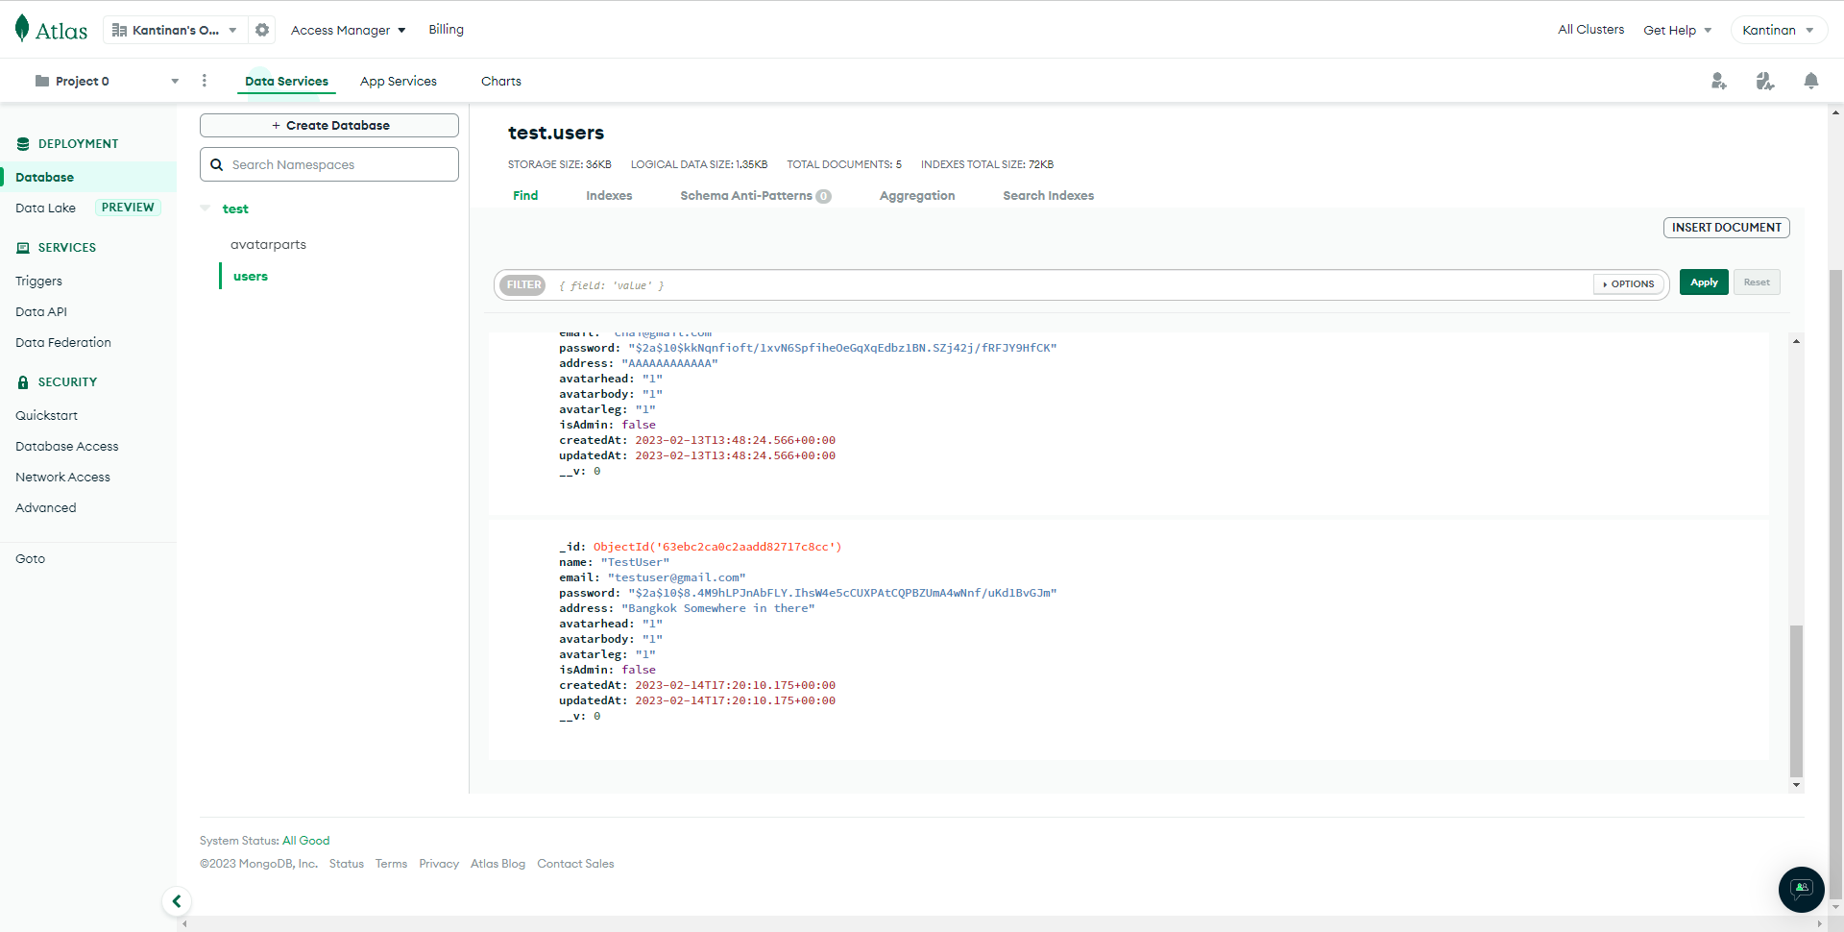
Database

Slide 16
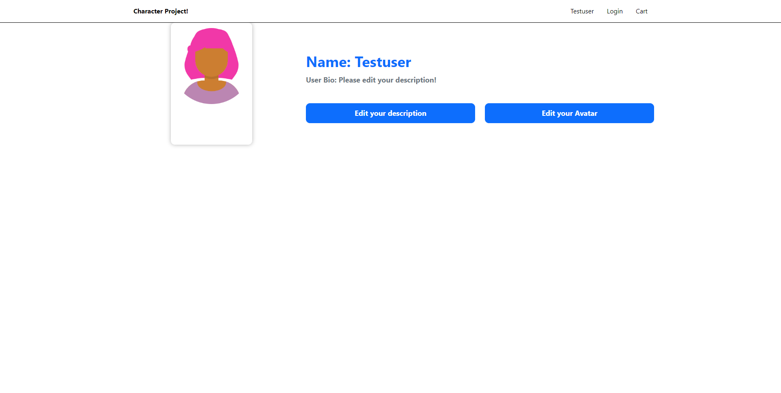
Profile

Slide 17
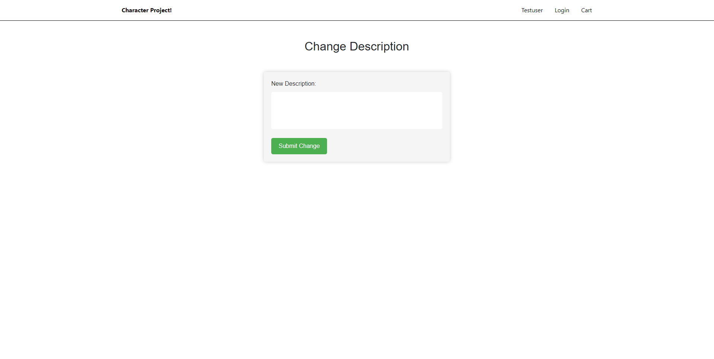
Profile

Slide 18
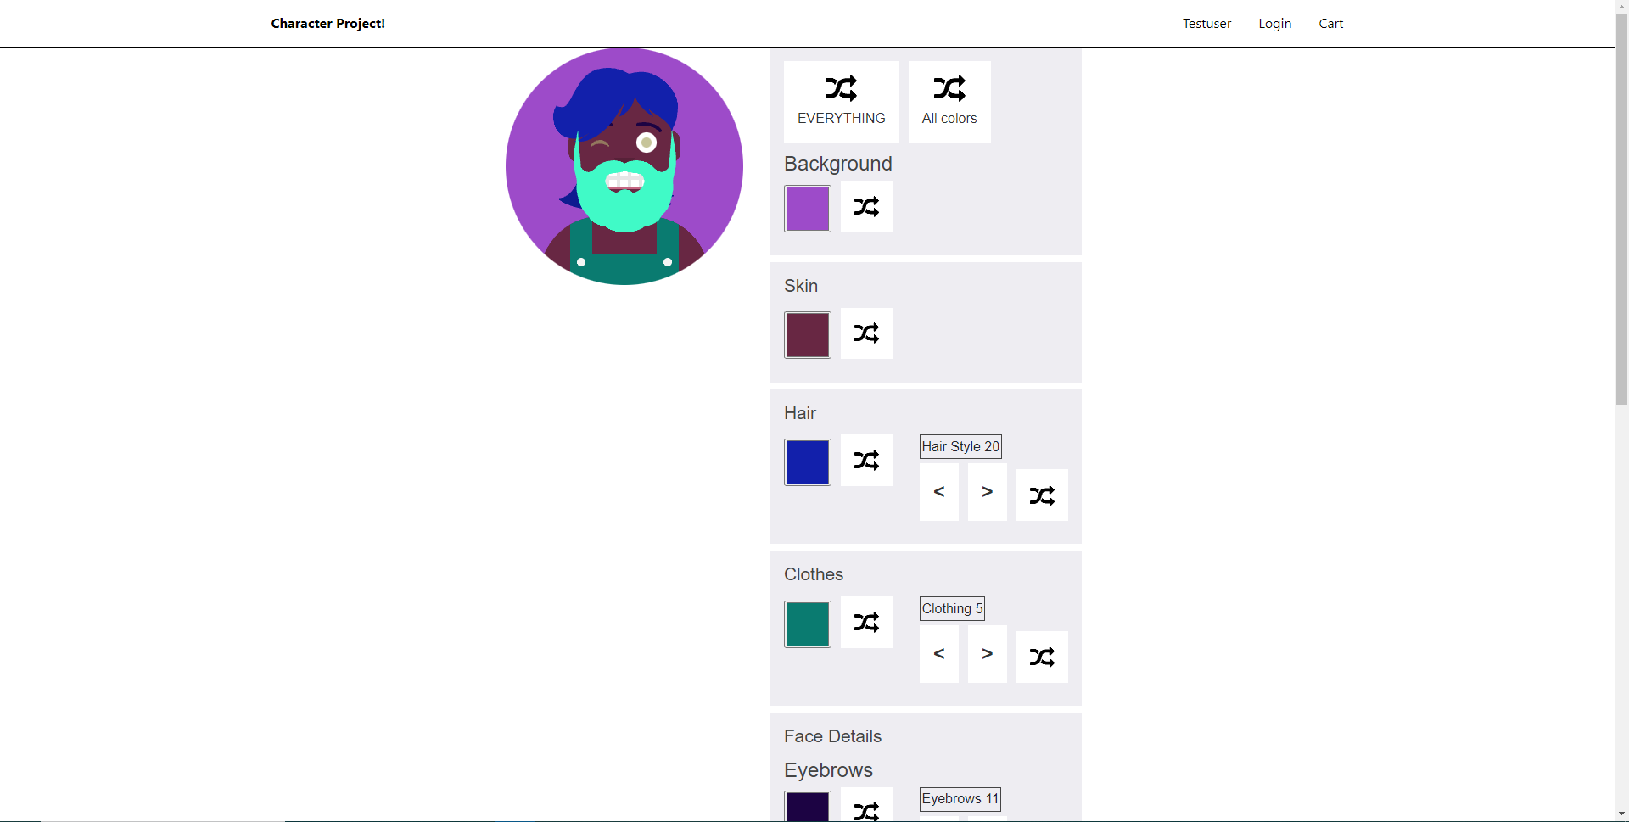
Profile

Slide 19
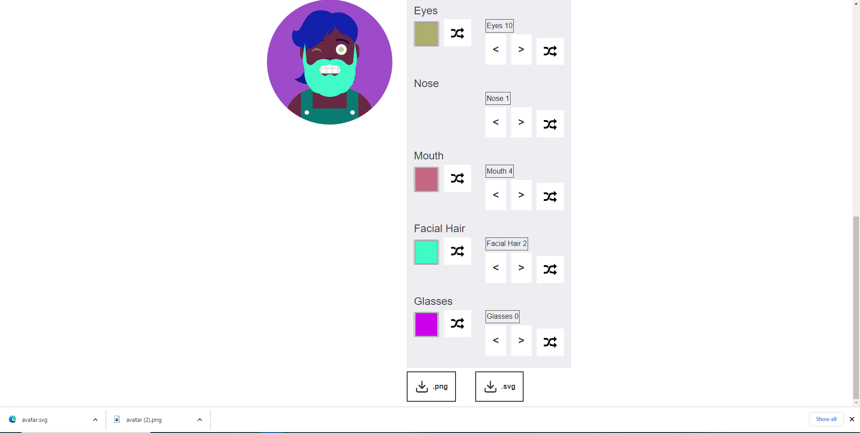
Profile

Slide 20
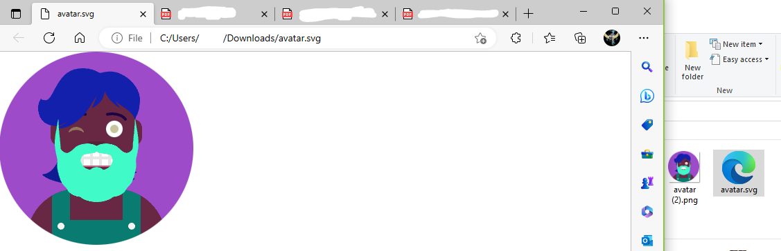
Profile

Slide 21
Problem Encounter
https://avatarmaker.com/
There are delays in completing work in each Sprint.
There are issues in work such as knowledge and abilities.
There are problems with design and planning such as the use and coordination of colors, organizing the components of functions, buttons, and other tool usage, etc.
Still brain dead!

Slide 22
Remains and problem.
Make UD in CRUD, now there is now such thing as U and D

Slide 23
Thank You

